Slide 1
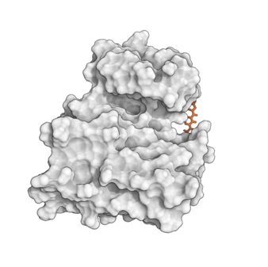
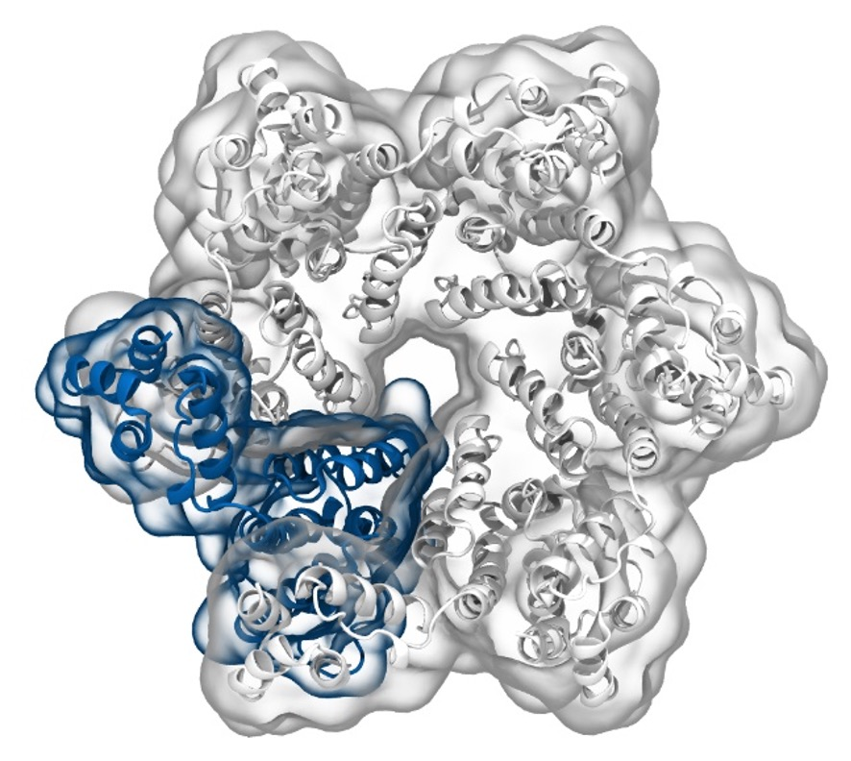
Simulation of Biomolecules
Setting up a protein
simulation
2024 CCP5 Summer School
Dr Matteo Degiacomi
Durham University
matteo.t.degiacomi@durham.ac.uk
Dr Antonia Mey
University of Edinburgh
antonia.mey@ed.ac.uk

Slide 2
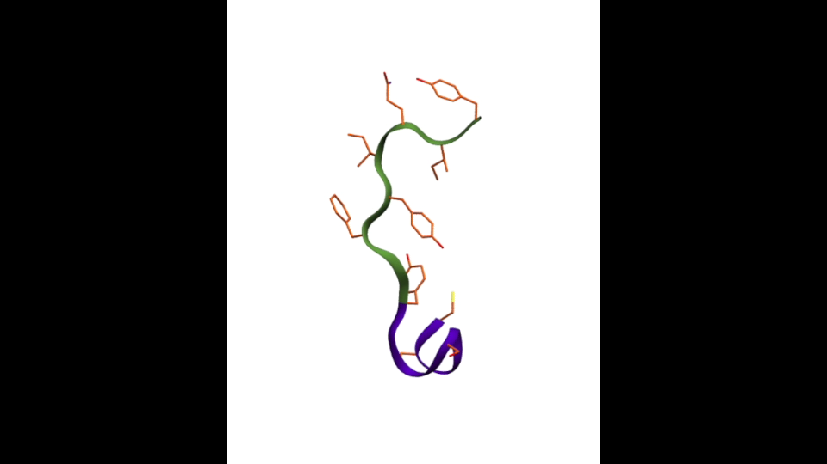


You will not run any MD simulation today, but you will learn how to set one up and how to analyse it

Slide 3
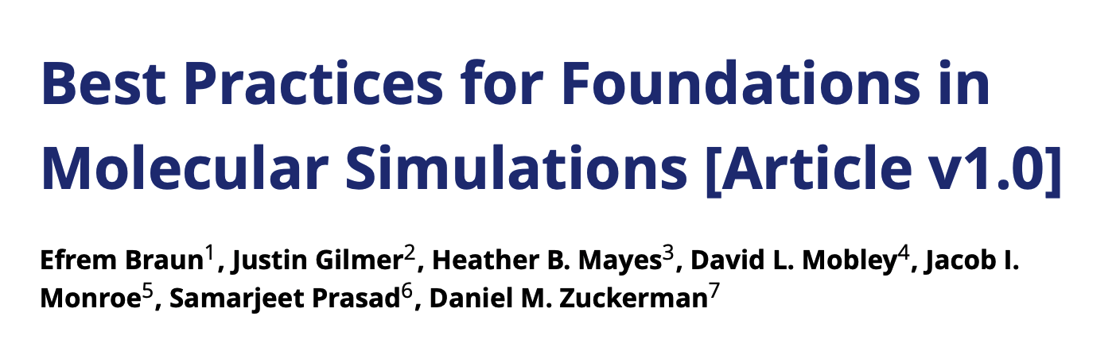
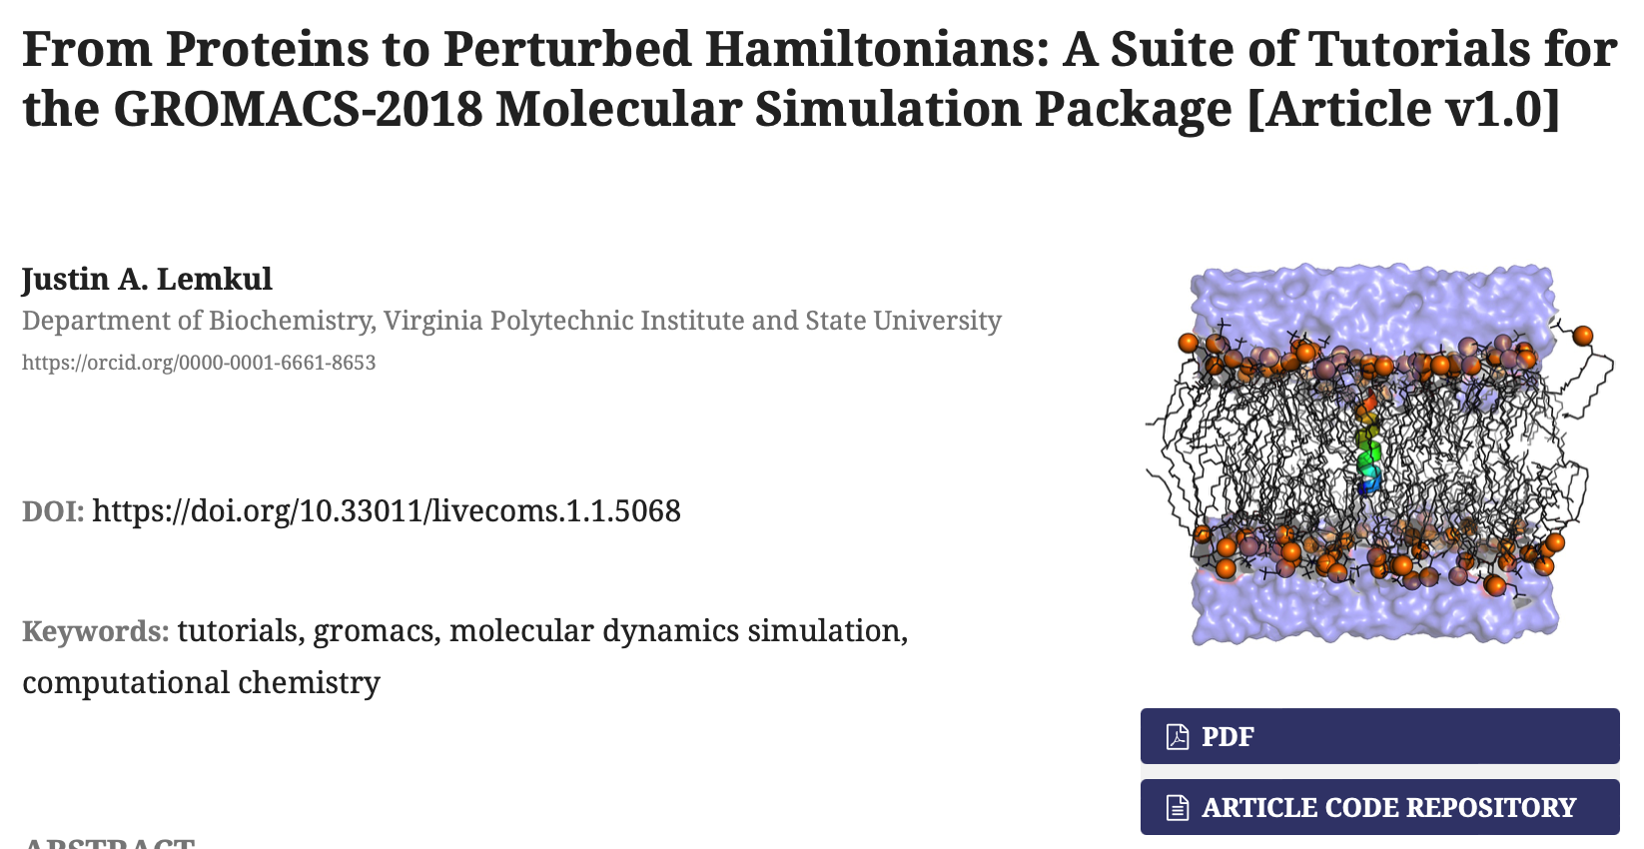
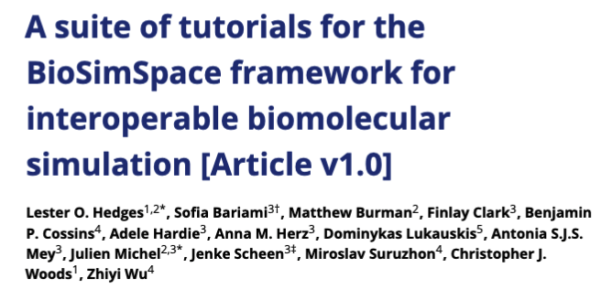
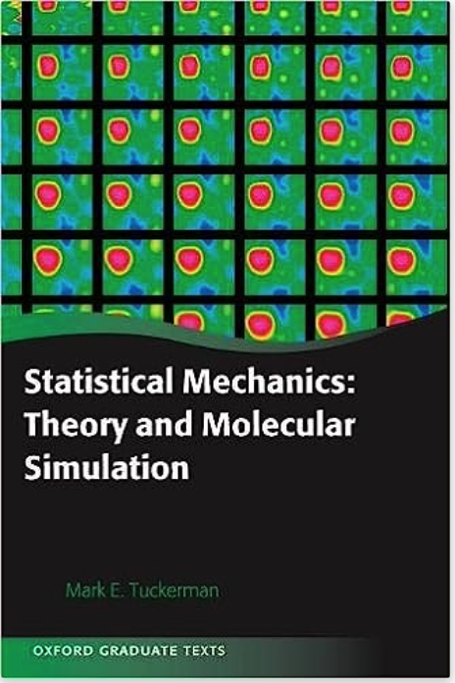
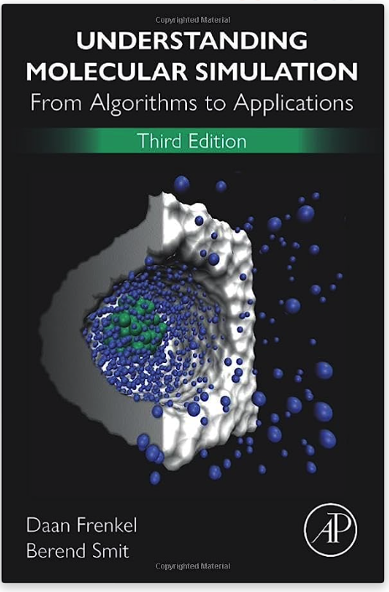
Useful resources to learn running simulations
GROMACS: tutorials.gromacs.org
Amber: ambermd.org/tutorials
OpenMM: docs.openmm.org/latest/userguide/library/03_tutorials.html

Slide 4
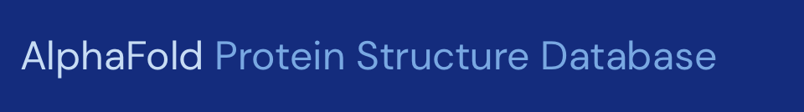

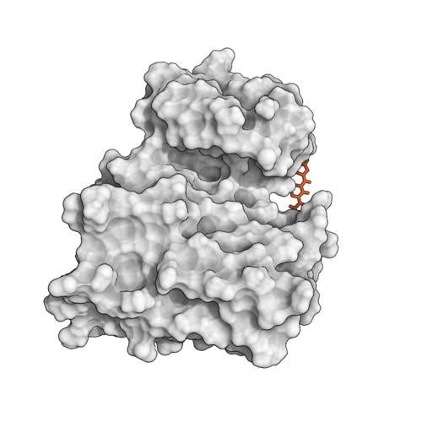
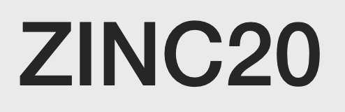

Starting point for setting up a simulation
Getting your protein structure
Prepping your protein and/or ligand(s)
Getting ready for your simulation…
Getting ligands/co-factors

Slide 5
A typical workflow for molecular dynamics
Get protein structure
Prep for simulation
Simulation setup
Gromacs
OpenMM
Python API
Run Simulation Protocol
Amber
NAMD
DLPoly
SOMD
Charmm
mostly C++
commandline
BioSimSpace
[…]
Simulation Analysis

Slide 6
A Molecular Dynamics timestep
Set initial conditions for x, v and box size
Compute forces
Compute new x and v for all atoms
Apply restraints to bonds
Scale x and v with thermo/barostat
Update x and v (with boundary conditions)

Slide 7
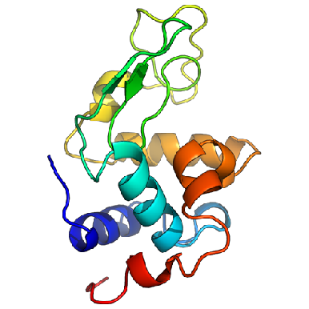
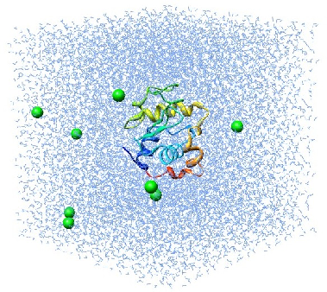
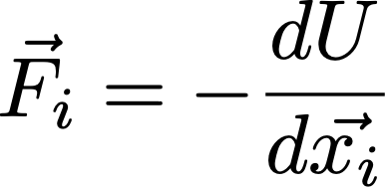
Molecular dynamics require multiple steps for the setup of simulations
Disulphide bridges
Protonation
Solvate in water and add ions
Crystal Waters
Cofactors
Alternative side chains
Solvated protein
Apply forcefield description
NVT/NPT equilibration
Minimize the positions
Equilibrated system
Solvated protein + forcefield
minimized protein
Production simulation
http://www.bevanlab.biochem.vt.edu/Pages/Personal/justin/gmx-tutorials/lysozyme/01_pdb2gmx.html
Levitt, Nature Structural Biology, 8, 392–393(2001)

Slide 8

There are many different choices for force fields to be made
Small molecule force fields
GAFF
Machine learned force fields
Amber (Peter Kollmann, UCSF) –Glycam parameters cover most sugars (Robert J. Woods, University of Georgia)
CHARMM (Martin Karplus, Harvard) –POPC, POPE, DPPC lipids
OPLS (William Jorgensen, Yale)
GROMOS (Wilfried van Gunsteren, ETHZ)
SchNet
Ani-2x
PhysNet
Espaloma
BandNN
There is no “best force field”!
Coarse-grained force fields…

Slide 9
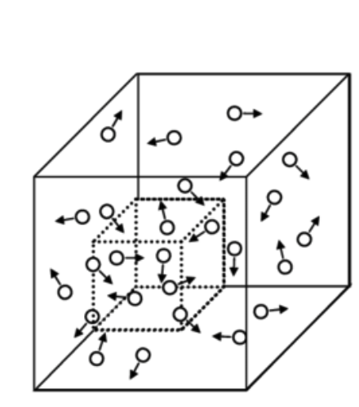
Choosing your thermodynamic ensemble
Simulations replicate a specific thermodynamic ensemble (typically NVT or NPT), or even grand canonical (μVT)
You will have different options to include thermostats (scaling atom velocities) and barostats (scaling positions) in your calculations:
Nose-Hoover
Berendsen
Parrinello-Rahman
Langevin piston
…
μVT
NVT/NPT equilibration
Minimize the positions
Equilibrated system
Solvated protein + forcefield
minimized protein

Slide 10
Periodic boundary conditions (PBC) and pressure coupling
…
…
…
…
If you want to simulate membrane systems, you want to chose semi-isotropic pressure coupling!
Typically, PBC in x-y-z

Slide 11
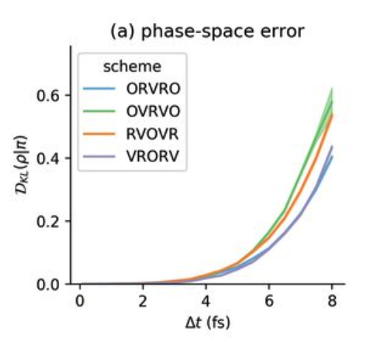
Sampling timescales for protein systems
The steepest gradient determines the smallest timestep:
Timestep size is imposed by the fastest phenomenon we want to observe :
Covalent bond hydrogen-heavy atom (10¹⁴ Hz): 0.5 fs
Covalent bond heavy atom-heavy atom: 1 fs
Angles fluctuations: 2 fs
Restraining covalent bond distances allows to use 1-2 fs timesteps (restraining methods: SHAKE, RATTLE, LINCS,…)
Hydrogen Mass repartitioning: 4 fs
Other integrators (e.g., Langevin): 4 fs - 6 fs.

Slide 12
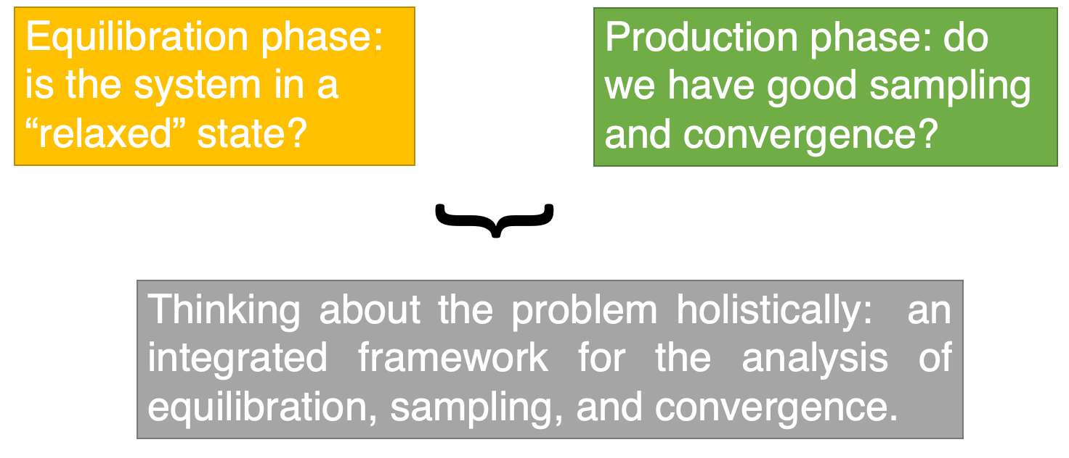
“equilibration” and “convergence”, what do they mean?

Slide 13
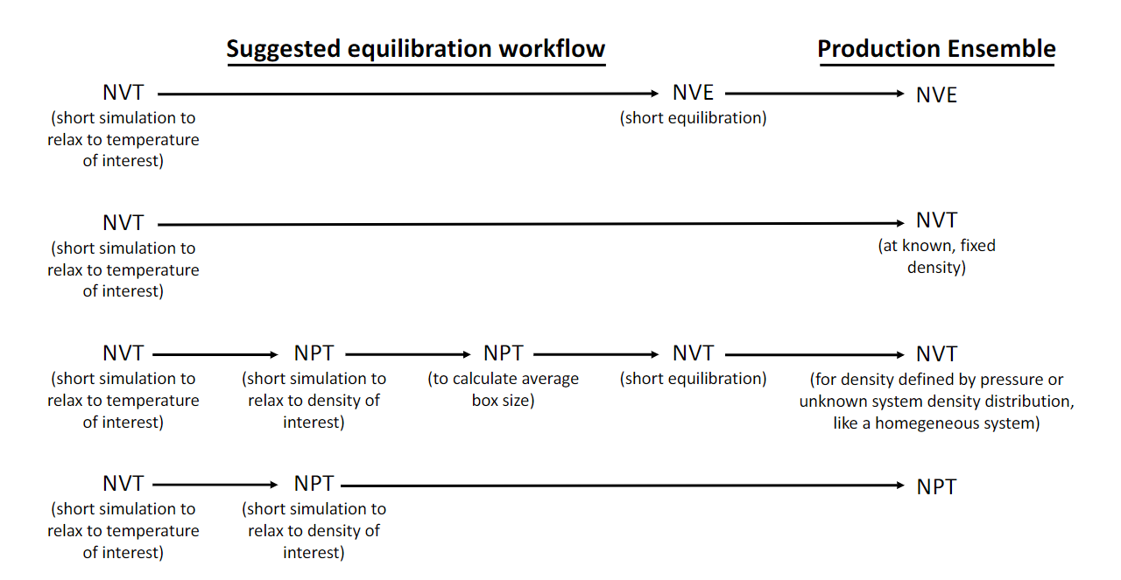
Example equilibration protocols
YOU WANT: constant volume, pressure, and temperature, healthy Ramachandran plot, no exotic chemistry, bulk water (if used)
Living J. Comp. Mol. Sci. 2019, 1, 5957

Slide 14
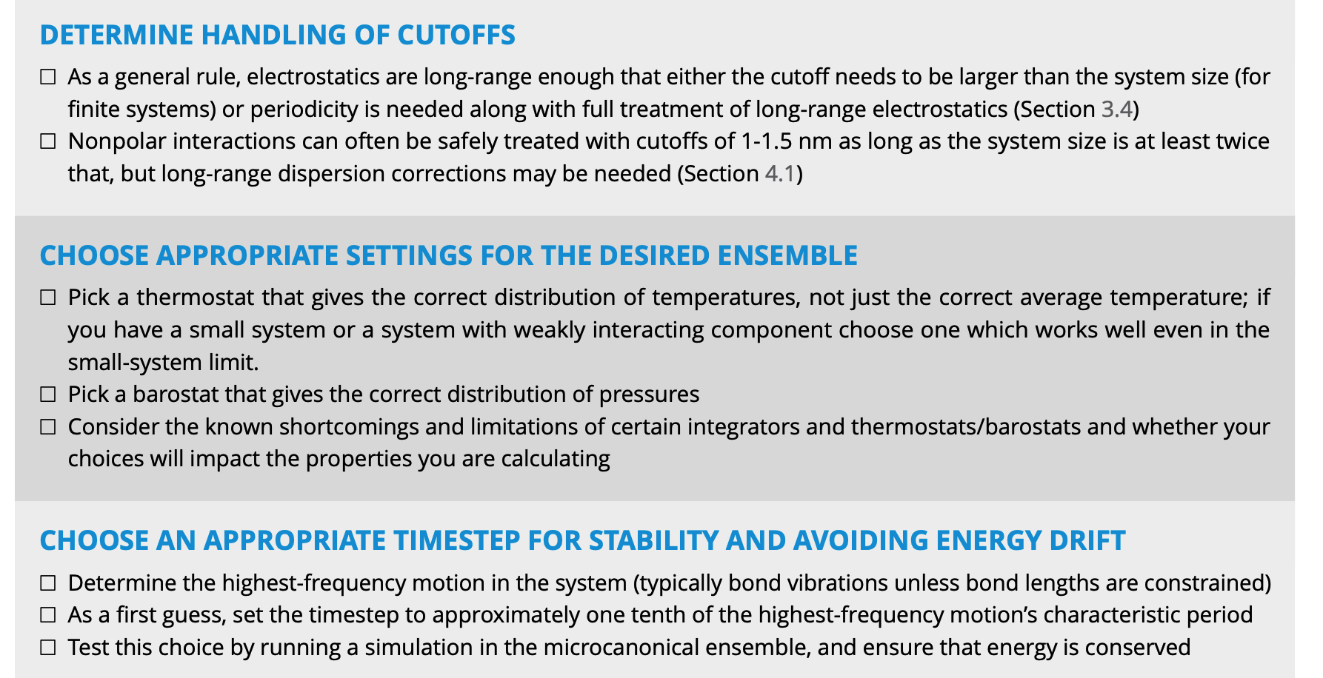
An example simulation protocol
YOU WANT: constant volume, pressure, and temperature, healthy Ramachandran plot, no exotic chemistry, bulk water (if used)
Equilibration:
Minimize energy, 1000 steepest descent
Heat system from 0 to 300 K in 500 ps, NPT, Berendsen barostat 1 atm. α-carbon restrained with 10 kcal/mol harmonic potential. 2 fs timestep, LINCS all bonds
1 ns nVT equilibration with Langevin dynamics, no atom constrained.
Production:
4. 1 µs NPT, Nose-Hoover barostat, PME for
electrostatics
Living J. Comp. Mol. Sci. 2019, 1, 5957

Slide 15
Get protein structure
Prep for simulation
Simulation setup
Run Simulation Protocol
Try at home
Simulation Analysis

